Slide 1

Analytical CRM Development for a Bank
A.VARSHITH
22/03/2026
Notes:
Line spacing + Page numbers

Slide 2
Agenda
Problem Statement
Data Overview
Workflow
Key Metrics & Insights
Recommendations
Conclusion

Slide 3

PROBLEM STATEMENT
You are an analytical CRM (Customer Relationship Management) specialist hired by a bank to extract meaningful insights from customer-related datasets.
The bank aims to reduce customer churn, improve service delivery, and enhance customer satisfaction.
The datasets provided include customer demographics, transaction details, customer exit information, and active customer profiles.

Slide 4
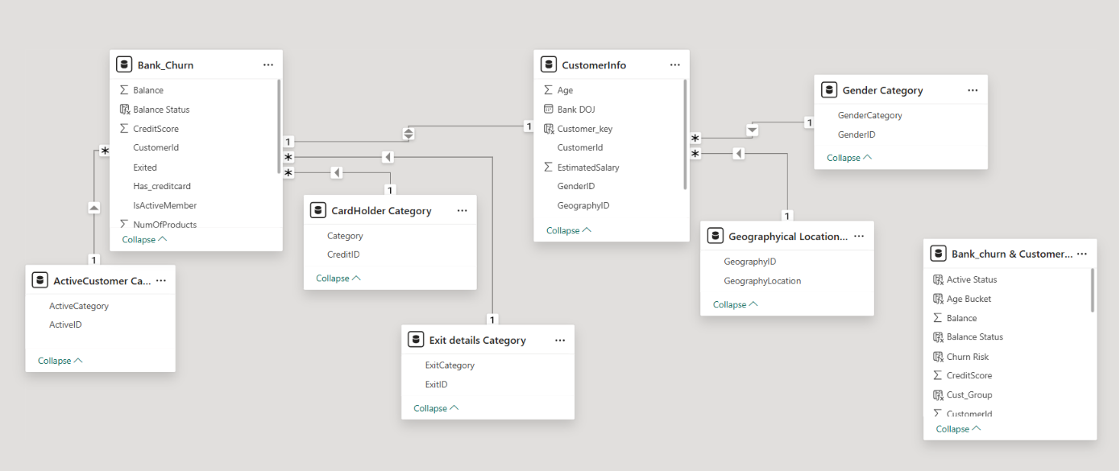
Dataset Overview

Slide 5
Dataset Overview
The project initially consisted of multiple datasets, including customer information, credit card details, activity status, geography, and exit information.
These datasets were consolidated and transformed into a single master dataset using Excel Power Query for efficient analysis.
It includes key customer attributes such as:
Customer Information (CustomerId, Surname, Gender, Age, Geography)
Account Details (Tenure, Balance, Number of Products)
Financial Metrics (Credit Score, Estimated Salary)
Customer Engagement (Active Status, Credit Card Usage)
Churn Information (Exited, Exit Category)

Slide 6
WORKFLOW
Data Acquisition from multiple source systems
Data Cleaning and Preprocessing using Excel Power Query
Data Integration and Transformation into a unified dataset
Data Storage and Querying using SQL
Data Visualization through interactive Power BI dashboards
Insight Generation to support data-driven decision making

Slide 7

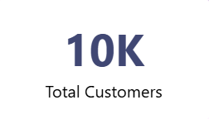
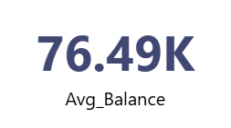
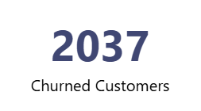
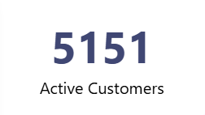
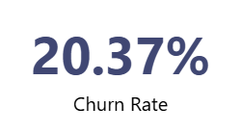
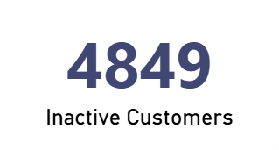
Key Performance Indicators

Slide 8
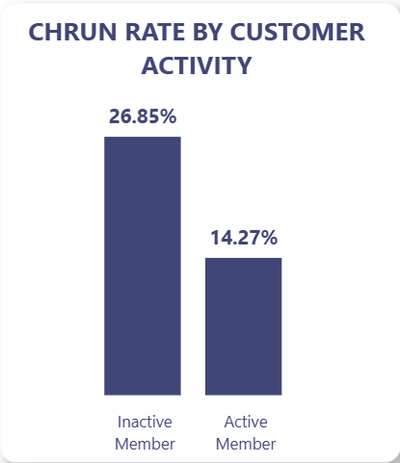
Churn Rate by Customer Activity
Inactive customers have a churn rate of 26.85%, compared to 14.27% for active customers.
The churn rate among inactive customers is nearly 1.9 times higher, indicating a strong link between inactivity and churn.
Lower engagement levels significantly increase the likelihood of customer exit.
Inactive customers are nearly twice as likely to churn as active customers.

Slide 9
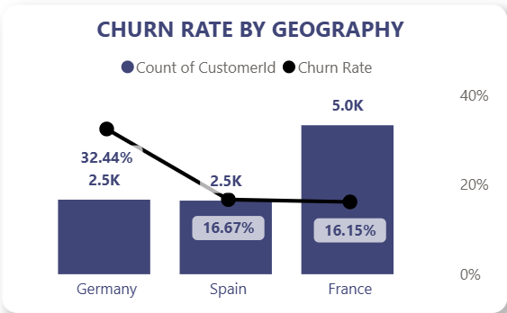
Churn Rate by Geography
Germany has the highest churn rate at 32.44%, which is nearly double compared to Spain (16.67%) and France (16.15%).
Despite having only 2.5K customers, Germany contributes disproportionately to overall churn due to its high churn rate.
France has the largest customer base (5K customers) but maintains a relatively low churn rate (16.15%), indicating better retention.
Germany shows the highest churn rate despite a smaller customer base.
9

Slide 10
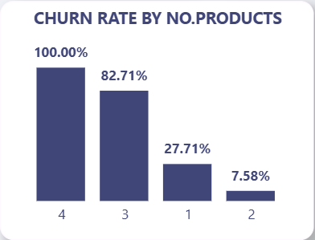
Churn Rate by Number of Products
Customers with 1 product have a churn rate of 27.71%, which is significantly higher than customers with 2 products (7.58%).
Customers with 3 (82.71%) and 4 products (100%) show very high churn rates, but these segments likely represent a smaller customer base.
The sharp drop in churn from 1 product to 2 products indicates that increased product adoption improves customer retention.
customers with a single product show higher churn, while multi-product users are more retained

Slide 11
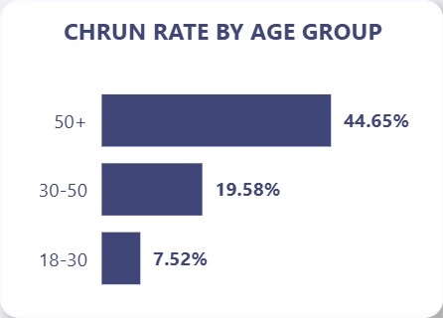
Churn Rate by Age Group
Customers aged 50+ have the highest churn rate at 44.65%, significantly higher than other groups
Customers aged 30–50 show moderate churn at 19.58%, while 18–30 have the lowest at 7.52%.
Churn risk increases with age, indicating older customers are more likely to leave.
Churn increases with age, with customers aged 50+ showing the highest risk.
11

Slide 12
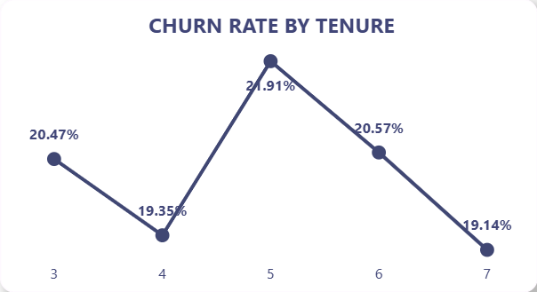
Churn Rate by Tenure
Churn rate fluctuates across tenure, peaking at 21.91% for tenure 5.
Customers with tenure 3 (20.47%) and 6 (20.57%) also show relatively higher churn levels.
Customers with higher tenure (7 years) have a lower churn rate (19.14%), indicating slightly better retention over time.
Churn varies across tenure, with no clear trend but moderate fluctuations.

Slide 13
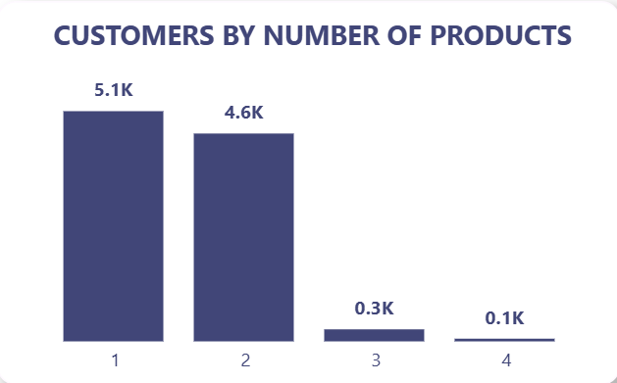
Customers by Number of Products
Majority of customers hold 1 (5.1K) or 2 products (4.6K), while very few customers use 3 (0.3K) or 4 products (0.1K).
A large portion of customers are concentrated in low product usage segments.
A large portion of customers are concentrated in low product usage segments.
Most customers use only 1–2 products, indicating low product engagement.
13

Slide 14
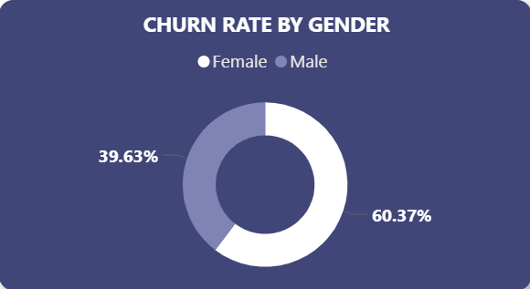
Churn Rate by Tenure
Female customers show a higher churn rate at 60.37%, compared to 39.63% for male customers.
The difference indicates a noticeable variation in churn behavior across gender segments.
Gender-based differences suggest potential variations in customer experience or engagement levels.
Female customers show a higher churn proportion compared to male customers.

Slide 15
Strategic Growth Framework
Retention Strategy
Target inactive customers, as they show higher churn (26.85% vs 14.27% for active users)
Focus on high-risk regions like Germany, which has the highest churn (32.44%).
Retain customers with low product usage, especially those with 1 product.
Product Strategy
Encourage customers to adopt multiple products, as churn drops significantly (27.71% to 7.58%)..
Promote bundled services to increase engagement and long-term retention.
Identify and upsell customers with low product usage.
Engagement Strategy
Focus on older customers (50+ with 44.65% churn) through targeted communication.
Improve customer activity levels to reduce inactivity-driven churn.
Strengthen engagement strategies across key customer segments.

Slide 16
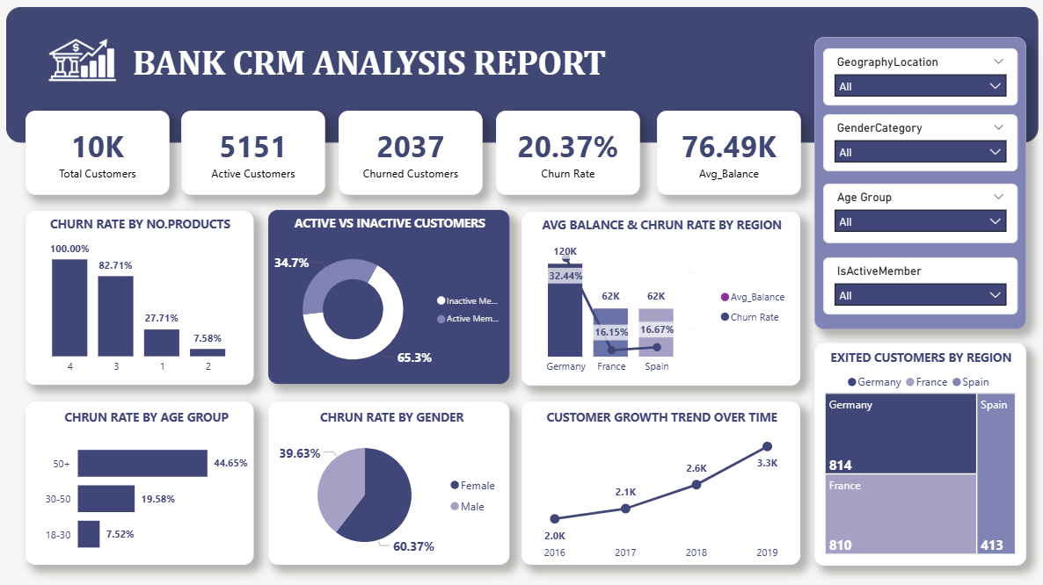
DASHBOARD -1

Slide 17
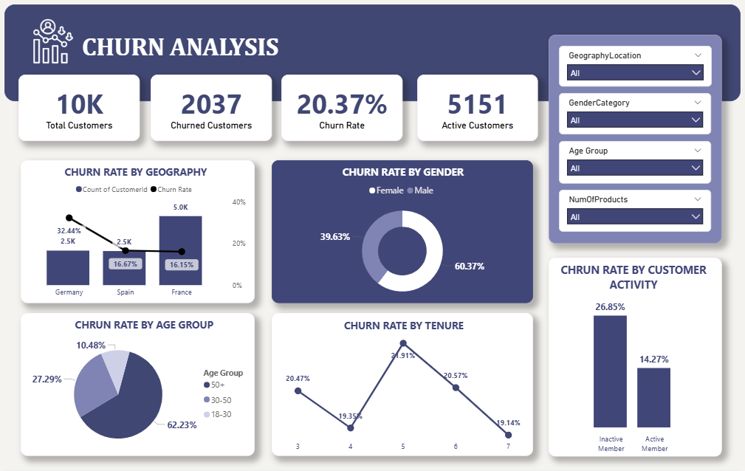
DASHBOARD -2

Slide 18
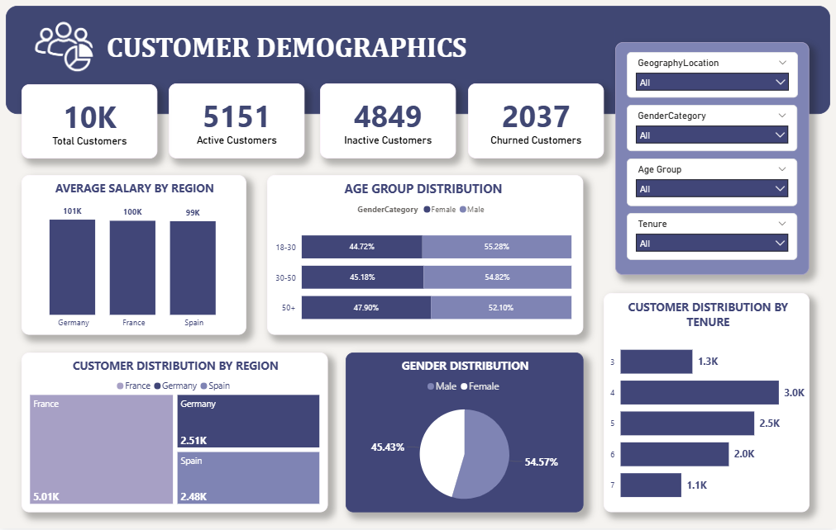
DASHBOARD -3

Slide 19
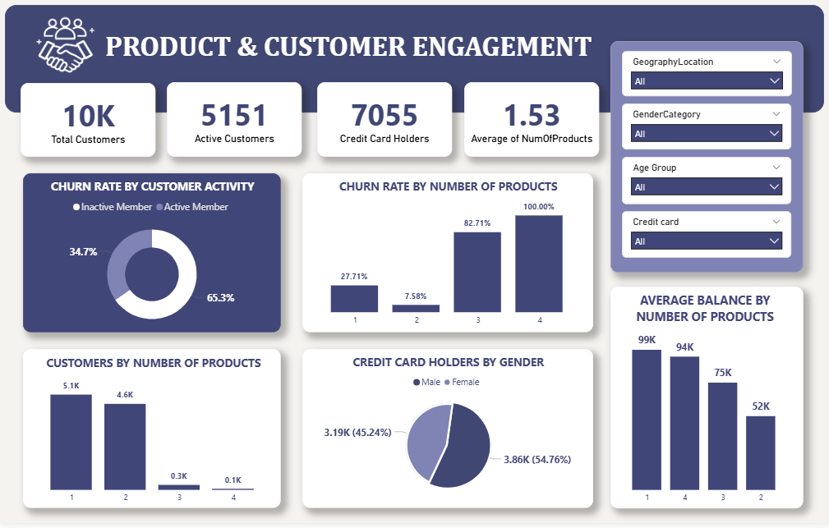
DASHBOARD -4

Slide 20

Recommendations
Prioritize inactive customers, as they show significantly higher churn (26.85% vs 14.27%).
Focus on Germany, which has the highest churn rate (32.44%) despite a smaller customer base
Encourage multi-product adoption, as churn reduces from 27.71% (1 product) to 7.58% (2 products).
Target older customers (50+ with 44.65% churn) through personalized engagement strategies.
Strengthen customer engagement initiatives to reduce inactivity-driven churn.
Monitor high-risk segments continuously to enable proactive retention actions

Slide 21

Conclusions & Key Takeaways
Customer churn is influenced by product usage, activity level, geography, and age.
Customer churn is influenced by product usage, activity level, geography, and age.
Customers with 1 product and inactive status are the most likely to churn.
Germany and older customers (50+) represent high-risk segments.
Increasing product adoption and improving engagement can significantly reduce churn.

Slide 22



